Slide 1
Spatiotemporal Data Management and Analytics Course Introduction
By Prof Xiaofang Zhou, Dr Lei Li and Dr Pingfu Chao
The University of Queensland

Slide 2
About Us
Teaching Team from The University of Queensland
Find more about us at:
https://www.itee.uq.edu.au/research/data-science
Prof Xiaofang Zhou zxf@itee.uq.edu.au Dr Lei Li l.li3@uq.edu.au Dr Pingfu Chao p.chao@uq.edu.au

Slide 3
Learning Materials
No Textbook
Lecture Notes
Tutorials
Survey Papers and Research Papers
Learning resources
Zoom for online lectures
微信群
微助教

Slide 4
Assessment
Attendance 40%
Group-based research report 60%

Slide 5
Pre-Requisite
Relational Database Systems
What is DBMS?
Databases (schema with constraints + data)
Management Software
Applications
What is SQL?
Declarative, Non-procedure
Indexing and Processing Optimization
B-Tree, Hash, and Bitmap
Push down the selection
Reduce the intermediate data size, reduce the disk visiting time
Algorithms & Data Structures
Trees and Graphs

Slide 6
The Spirit of Database Systems
Database is not just about storage!
How to retrieve and use the data
View everything in this world as data
Big data
View every problem in this world as query
Computing with algorithm
Bounded by the time complexity, boomed by data size
Precomputed
Extremely fast data retrieval, huge data size
How to answer the problem efficiently with less storage cost?
Indexing

Slide 7
Data Model
Model: Different ways to achieve a goal
Computation Models
In-memory, External memory, Distributed computing…
Machine Learning Models
Bayesian Model, Hidden Markov Model, Neural Network Model…
…
Data Models
A data model is the model through which we perceive and manipulate data in a database.
For people using a database, the data model describes how we interact with the data in a database.
Store → Operations → Efficiency
Data → Algorithm → Index

Slide 8
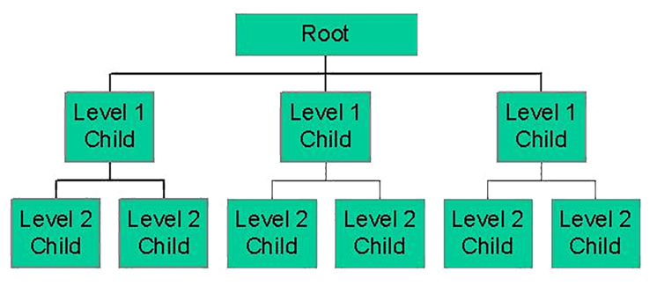
60s: Hierarchical Model
Why starting from 60s?
Early day computers / programs
"If we could put a man on the Moon, could we also create a computer program to track the millions of rocket parts it takes?”
IBM Information Management System (IMS)
Tree-like structure
The data is stored as records which are connected to one another through links
A record is a collection of fields, with each field containing only one value
Does it remind you of XML and JSON?

Slide 9
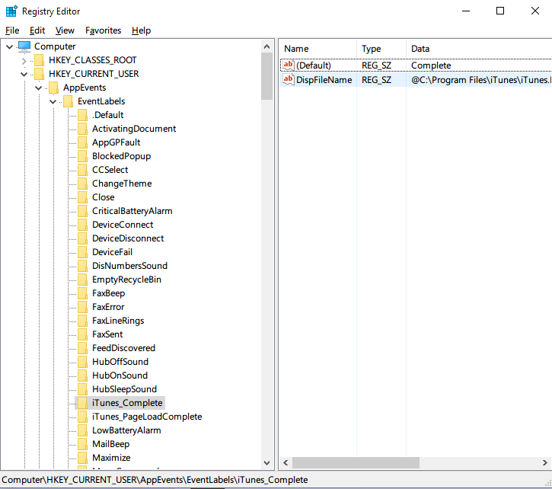
Hierarchical Model

Slide 10
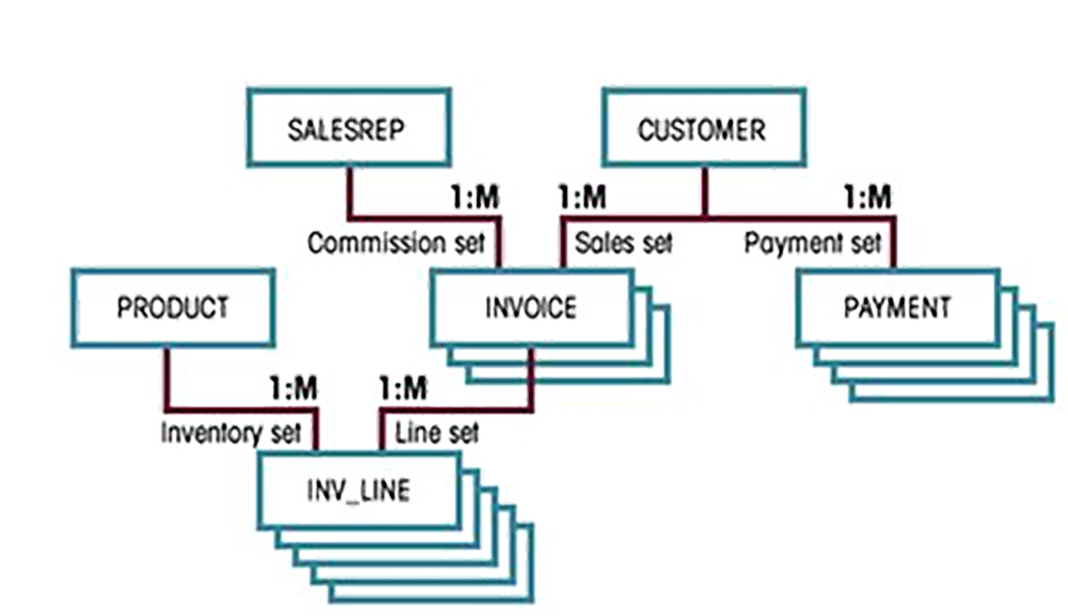
60s: Network Model
Graph-like structure
Allows a more natural modeling of relationships between entities

Slide 11
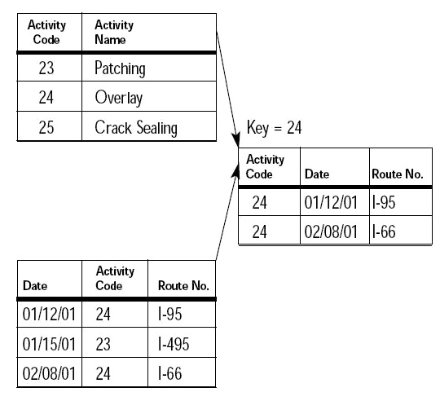
Relational Model
Problems with pointer-based models?
The Relational Model is a value-based
Codd “A Relational Model of Data for Large Shared Data Banks”, 1970
Table is the foundation
1NF, 2NF, 3NF,…
Relational algebra / Calculus / Theory
Join
Theory and research
Ingres/Postgres

Slide 12
80s: Relational Model
Standard data model
Schema
Predefined
Constraints
Separate with programs
SQL
Concurrency
With ACID
Efficiency
Query processing and indexing
Data migration and integration
Commercial systems

Slide 13
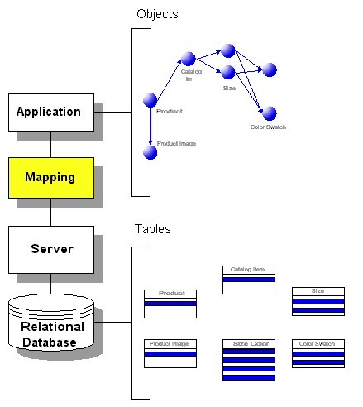
Relational Model
Disadvantage
Impedance mismatch
Two sides of a coin

Slide 14
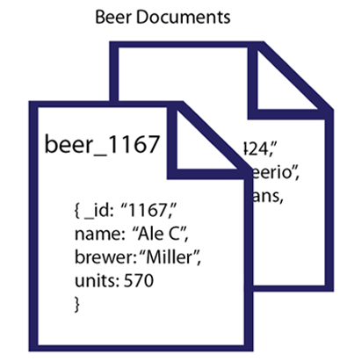
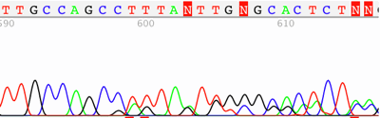
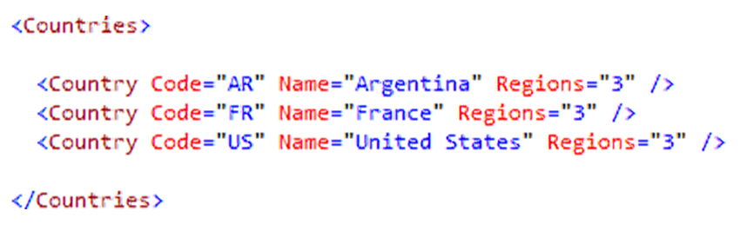
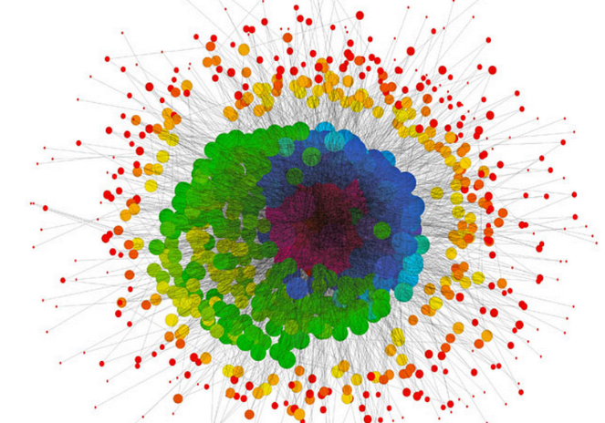
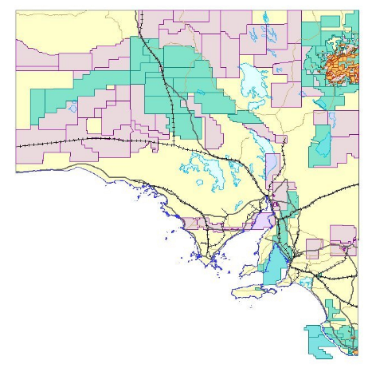
Relational Model: Disadvantages
Disadvantages
New data types
Documents
Sequences
Graphs
XML data
Spatial
Multimedia data

Slide 15
Relational Model: Disadvantages...
Disadvantages
New applications
Anything that contains the new data types
Big data
Hard to Scale out on clusters
Low availability
Slow
What if only needs a column in a table with hundreds of columns
Store flexible information that violates the predefined schema
…
Can only handle 1-Dimensional Data
Bitmap, Hash, B-Tree to index higher dimension?

Slide 16
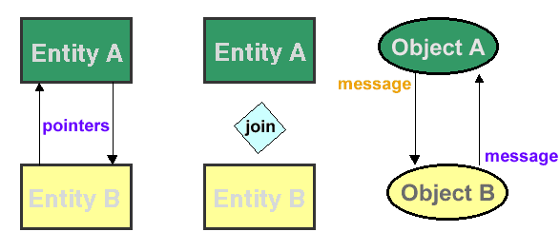
90s: Object-Oriented Data Model
Information is represented in the form of objects as used in object-oriented programming
Add new object storage capabilities to the relational systems
Time-series data
Geospatial data
Diverse binary media such as audio, video, images, and applets
Encapsulate methods with data structures
Data and Program are mixed together

Slide 17
2010s: NoSQL
Non-SQL →Not only SQL
Key-Value store, Document, Column store, Graph,…
Non-relational, Schema-less, No query language
Able to dynamically add new attributes
Built from the ground up to handle new data challenges
To store flexible documents → Document store database
To retrieve column data efficiently → Column store database
To store large amount of different kinds of data → K-V database
Open source
Cluster friendly
Horizontally scale simple operations throughput over many servers
Able to replicate and partition data over many servers

Slide 18
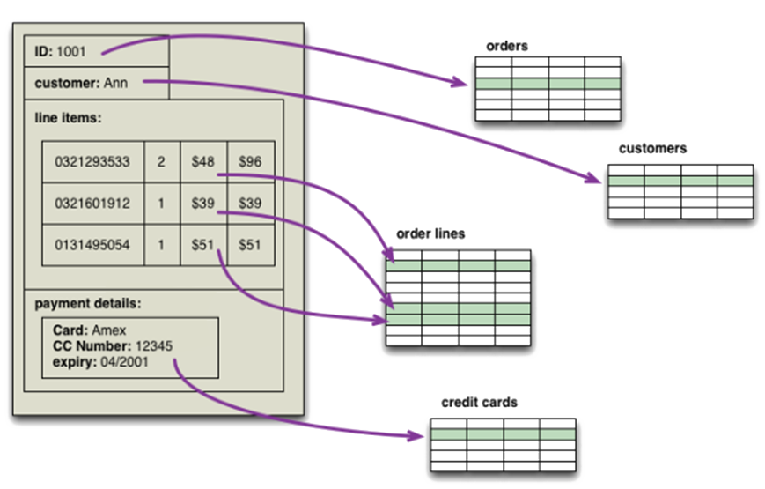
Aggregate Data Model
A collection of related data objects that to be treated as a unit

Slide 19
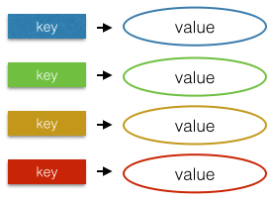
Key-Value Store Model
Hash Key
Value can be anything
BLOB
Binary Large OBject
Value
Document
Videos
…
Aggregate

Slide 20
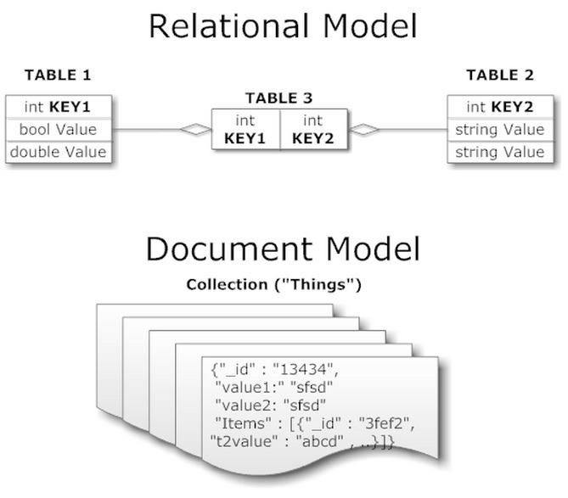
Document Model

Slide 21
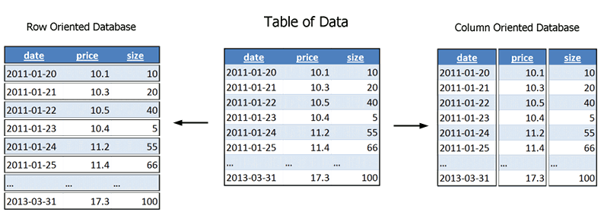
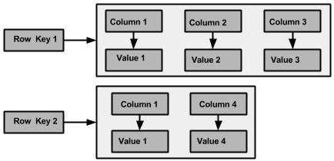
Column Family Store Model
Components
Key-value: Row->value
Column families
No schema
Can be different

Slide 22
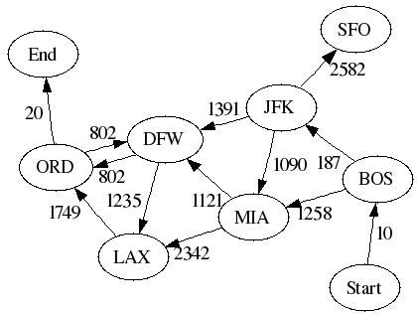
Graph Model
Relational Model
Complex Entity + Simple Relation
Graph Model
Simple Entity + Complex Relation
Node: Entity
Edge: Relation
Property: properties of entities and relations

Slide 23
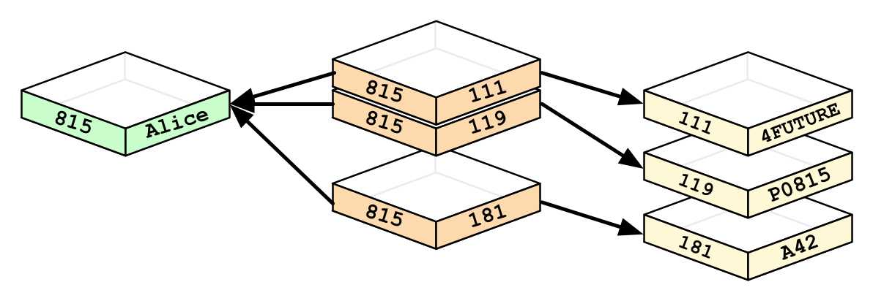
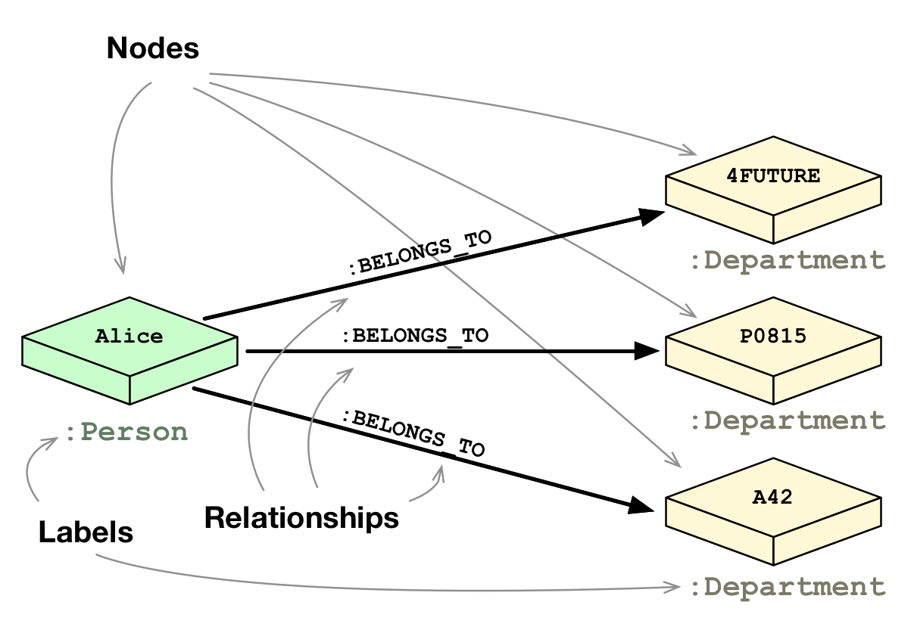
Graph Model
Neo4j
SELECT name
FROM Person
LEFT JOIN Person_Department
ON Person.Id = Person_Department.PersonId
LEFT JOIN Department
ON Department.Id = Person_Department.DepartmentId
WHERE Department.name = "IT Department"
MATCH (p:Person)<-[:EMPLOYEE]-(d:Department)
WHERE d.name = "IT Department"
RETURN p.name

Slide 24
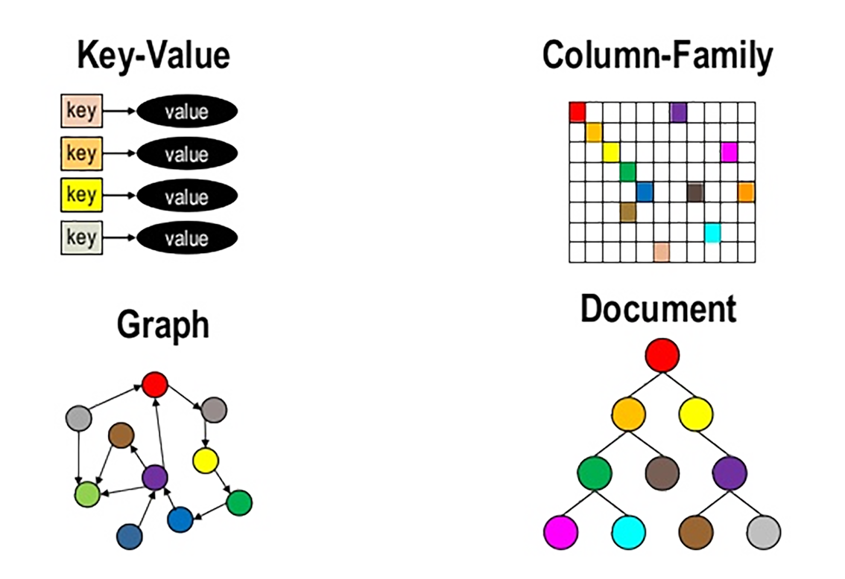
NoSQL Patterns

Slide 25
Beyond RDBMS
History of DBMS
The 60s: Tree, Network
The 70s, 80s: Relation
The 90s: Object-Oriented, Spatial Data
New millennium: Big Data, NoSQL
Beyond RDBMS
Spatial and temporal attributes are ubiquitous
But they are poorly support by RDBMS…
One fundamental change:
#dimensions increases from 1, to 2, to several, to many…

Slide 26
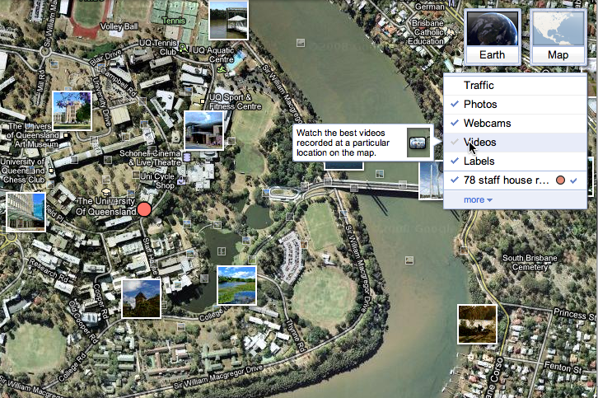
Google Earth

Slide 27
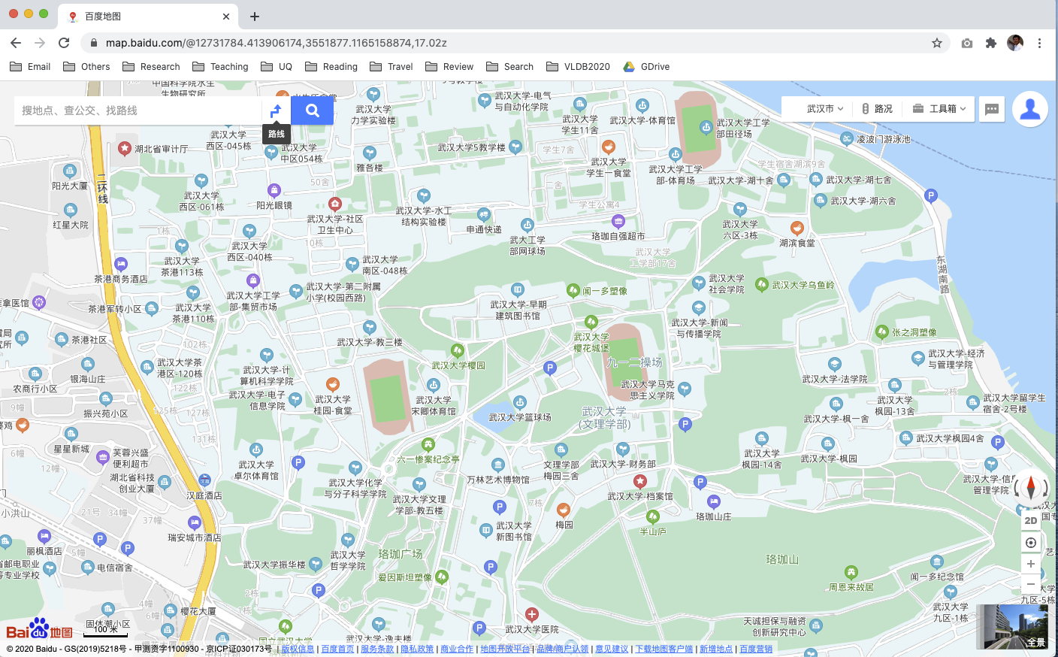
Baidu Maps

Slide 28
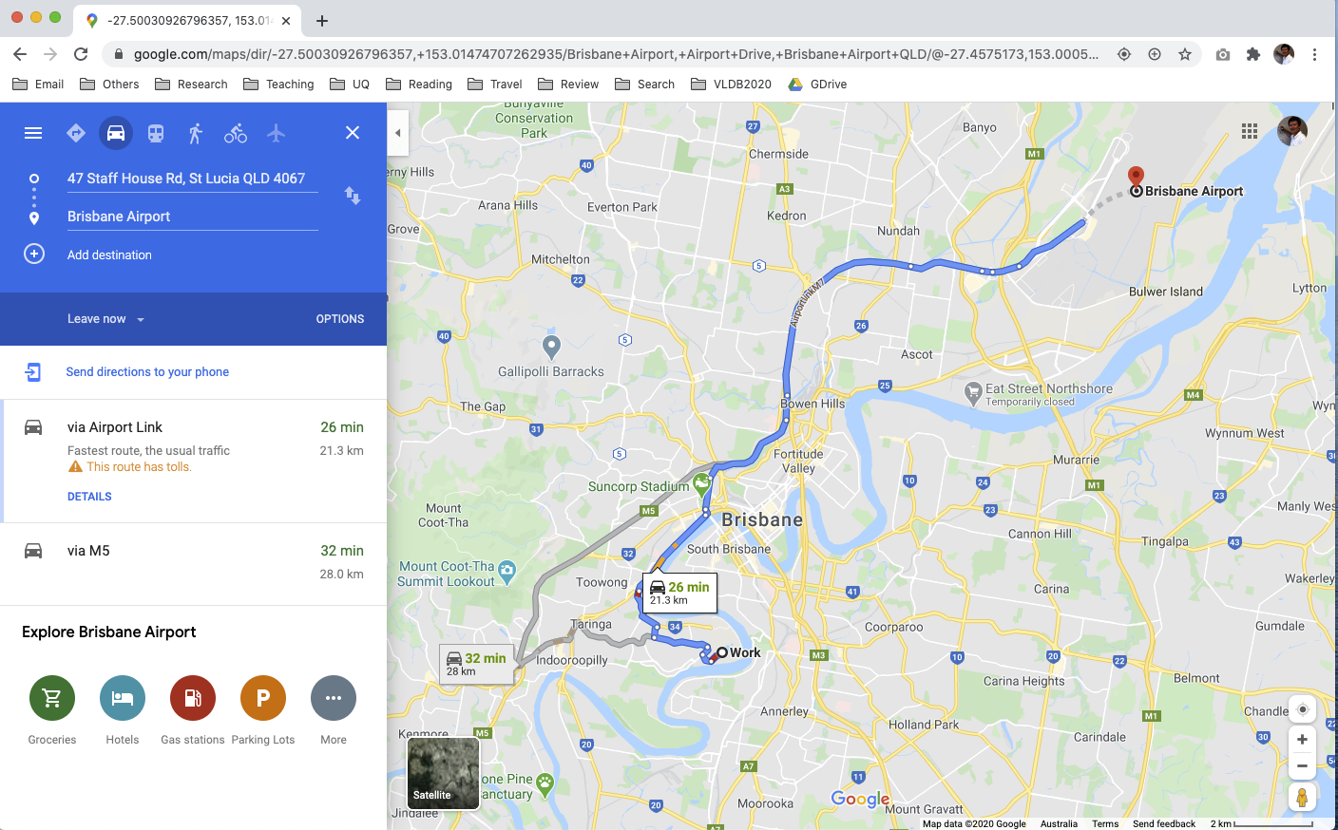
Google Mpas

Slide 29
Modern Database Applications
Very large datasets
Many with streaming nature too
Complex data structures
Often represented as high dimensional data
Many with spatial and temporal attributes (timestamp)
One application often needs to integrate heterogeneous data from many sources
Data analytics queries
Databases, Data Warehouses, Data Mining, Machine Learning…
Again: Database is not about storage
How to retrieve and use the data

Slide 30
The Three Vs of Big Data
Volume, Velocity and Variety
YouTube:
Serves around 2 Billions videos per day
GIS/Geospatial:
Sales of software and data grow dramatically
Location-based Services (LBS):
Global market about US$30 billion
Sensor Data
(Radio Frequency ID) RFID, On-Board Diagnostics (OBD)…
Transaction
Interaction
Sensorization

Slide 31
This Course
What will we learn?
The latest in large-scale data management and processing: complex data types and similarity-based queries
How to represent and manage complex data to enable efficient processing of advanced queries
Applicable to a wide range of applications, including spatial and multimedia data, text and web data, scientific data…
How will we learn?
Attending lectures
Attending tutorials
Studying selected research papers
Discuss on Piazza
Doing individual assignments
Participating group project actively

Slide 32
What to be Covered
Spatial Databases Introduction
Spatial Data Types, Data Structures and Spatial Databases
Spatial Indexing Mechanisms
Spatial Algorithms and Query Processing
Spatiotemporal Data Management
High-Dimensional Indexing, Search and Applications
Routing Planning

Slide 33
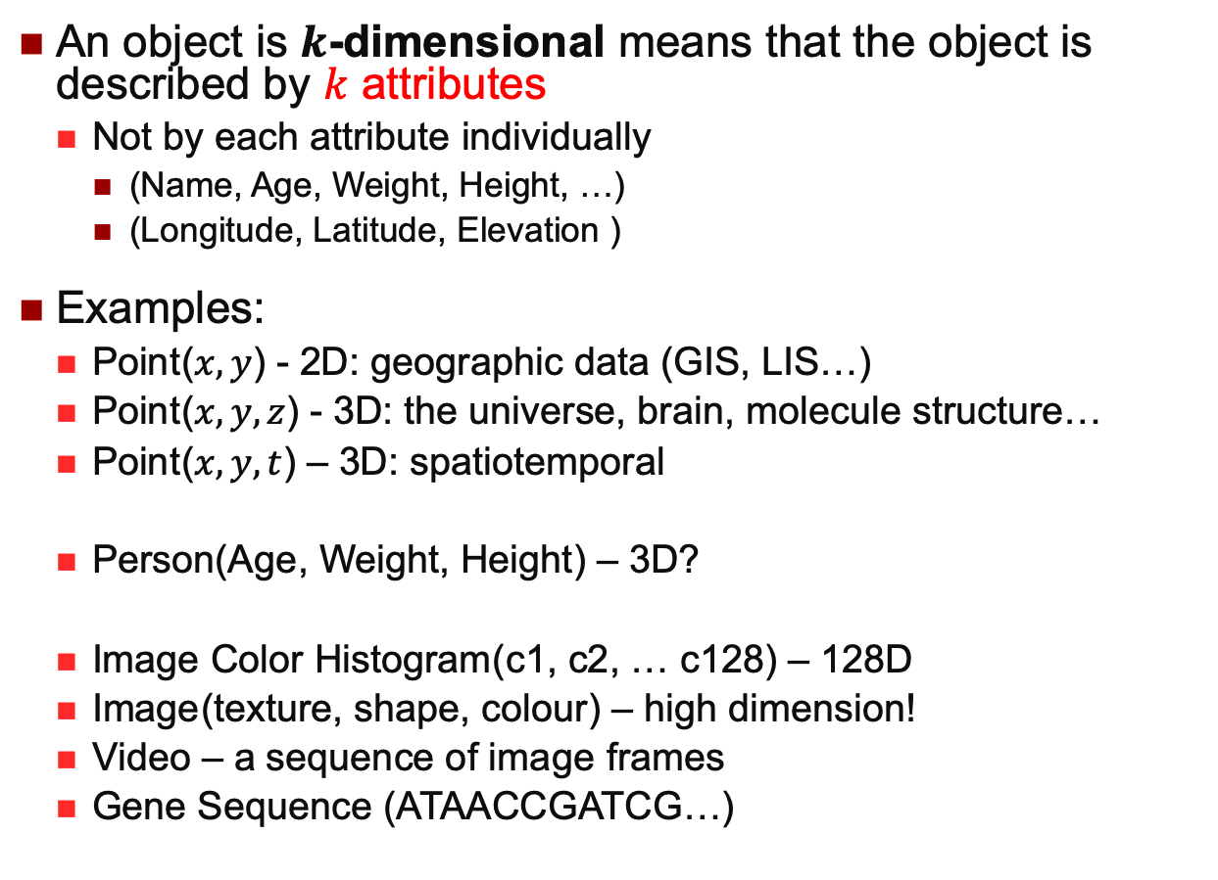
Multidimensional Data
An object is $k$-dimensional means that the object is described by $k$ attributes
Not by each attribute individually
(Name, Age, Weight, Height, …)
(Longitude, Latitude, Elevation )
Examples:
Point($x, y$) - 2D: geographic data (GIS, LIS…)
Point($x, y, z$) - 3D: the universe, brain, molecule structure…
Point($x, y, t$) – 3D: spatiotemporal
Person(Age, Weight, Height) – 3D?
Image Color Histogram(c1, c2, … c128) – 128D
Image(texture, shape, colour) – high dimension!
Video – a sequence of image frames
Gene Sequence (ATAACCGATCG…)

Slide 34
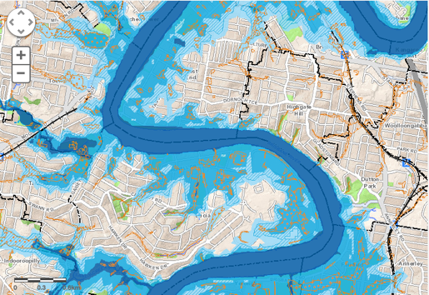
Why Spatial Databases?
One of the most widely used multidimensional databases
Foundation of understanding other high-D data
Many important application domains have spatial data and queries. Some Examples:
Insurance Risk Manager: Which homes are most likely to be affected in the next great flood on the Brisbane river?
Molecular Biologist: Is the topology of the amino acid biosynthesis gene in the genome found in any other sequence feature map in the database?
Medical Doctor: Based on this patient's MRI, have we treated somebody with a similar condition?

Slide 35
How About Relational DBMS?
Highly successful
Data Independence
Relational model
Non-Procedural Query
Efficiency & Performance
Indexing and Query Optimization
Allows concurrent access to data
Reliability
Persistence across failures
ACID

Slide 36
How About Relational DBMS?
Non-spatial
Queries
Where is Building 78?
Which courses are meeting in GP Building?
Which buildings are adjacent to the lake?
Which building is adjacent to a lake?
spatial

Slide 37
What’s Special about Spatial Queries?
Retrieval & update of spatial data is based on the spatial location of a data object
(vs. alphanumeric in RDBMS)
Fast execution of geometric operations
(vs. simple comparison in RDBMS)
RDBMS Obvious limitations
Limited data types – no support for multidimensional data!
Limited query types

Slide 38
Spatial DBMS (SDBMS)
A SDBMS is a software module that
Can work with an underlying DBMS
Supports spatial data models, spatial abstract data types (ADTs)
Supports a spatial query language
Supports spatial indexing, efficient algorithms for processing spatial operations, and domain specific query optimization
Examples:
Oracle Spatial and Graph in 12c (formally Oracle Spatial Extension of Oracle 8 in 1997), now separately licensed
Microsoft SQL Server supports spatial types since 2008
PostgreSQL DBMS uses the spatial extension PostGIS
Various of Spatial extensions on NoSQL systems

Slide 39
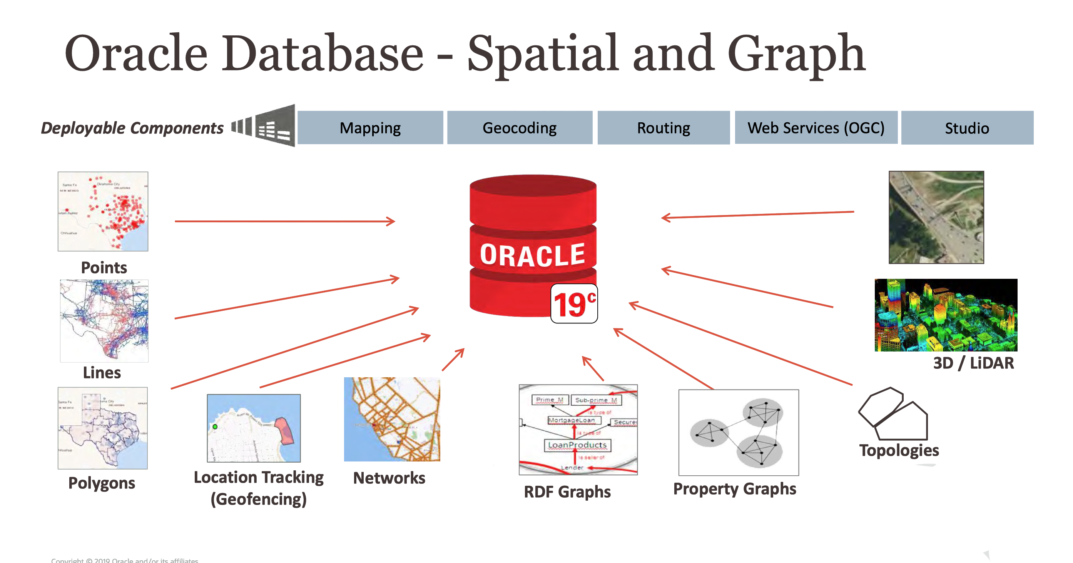
Spatial DBMS (SDBMS)

Slide 40
Spatial DBMS (SDBMS)
Microsoft SQL Server

Slide 41
How to Organize Spatial Data
Basic indexing methods in relational DBMS
B-Tree
Hashing
Bitmap
Two strategies to organize space and objects
Map spatial objects into 1D space and use a standard index structure (B-tree)
Dedicated external data structures
Basic ideas
Approximation
Bounding box, Grids
Hierarchical Data Organization

Slide 42
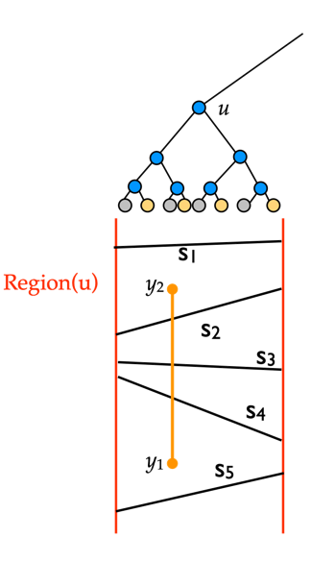
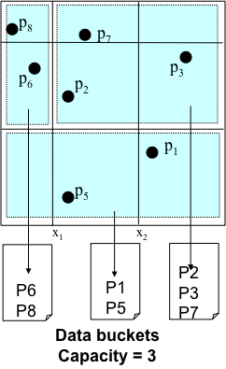
How to Organize Spatial Data
One Dimensional
Hashing and B-Trees
Line Data
Interval Tree, Segment Tree
Point Data
Hashing: GRID and EXCELL
Hierarchical
Quadtree: Point and Region Quadtrees
kd-Tree
Z-values and B-tree
Polygon Data
Transformation: End point mapping and z-values
Overlapping: R-tree and R*-tree
Clipping: R⁺-tree

Slide 43
Spatial Query Processing
Spatial operations are intrinsically more expensive than relational operations
Large amount of complex data
→ higher I/O cost
Computational geometry algorithms
→ higher CPU cost
Spatial query processing is different from RDBMS query processing
Different types of indexes
CPU costs typically not considered in RDBMS query optimization
Point in Rectangle
Rectangle intersection
Point in Polygon
Polygon intersection
Polyline intersection

Slide 44
Spatial Query Processing
Other types of spaces
Euclidean space – simple but not always realistic
Network space and surface space
Computing the distance between two points becomes very time consuming
Other types of relationships
Point query and range query
Selection query vs join query
Nearest neighbor and skyline queries
Very different query processing strategies
With applications beyond spatial databases

Slide 45
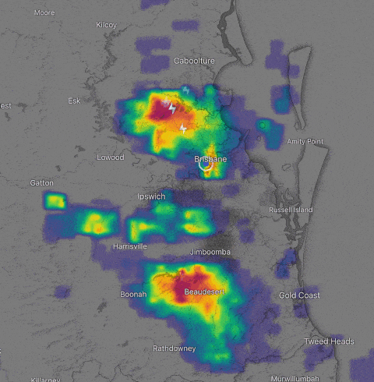
Managing Spatial Temporal Data
GPS recordings
Sensor data, RFID data and surveillance data
Use of smartphones and smartcards
Use of location-aware apps
Social media data: uploaded photos/messages and check-in data
Much more spatiotemporal data to come with 5G
…and beyond the geographical domain

Slide 46
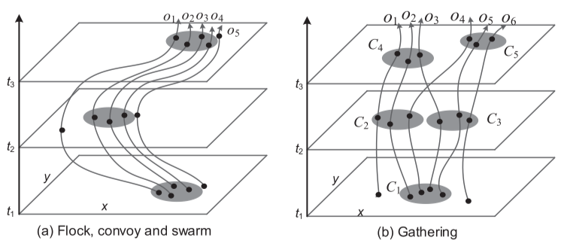
Spatial Temporal Data Mining
Trajectory clustering
Partition-and-group, and partition based on MDL
Trajectory pattern mining
Long trajectories are divided based a duration T, and then they are aligned and points are density-based clustered
Finding convoys
A group of objects travelling together for long enough
Used line simplification algorithms for efficiency
Finding “swarms”
Allow temporary divergence

Slide 47
Multidimensional Data
Indexing high-dimensional feature vectors
Cost factors
I/O cost: Disk page accesses
CPU cost: Computation of similarity/distance
As dimensionality increases, the portion of CPU cost in total response time increases too
This is different from traditional databases, where only I/O costs are considered
Dimensionality Curse
The performance of an index degrades rapidly as dimensionality increases, and eventually underperforms linear scan!

Slide 48
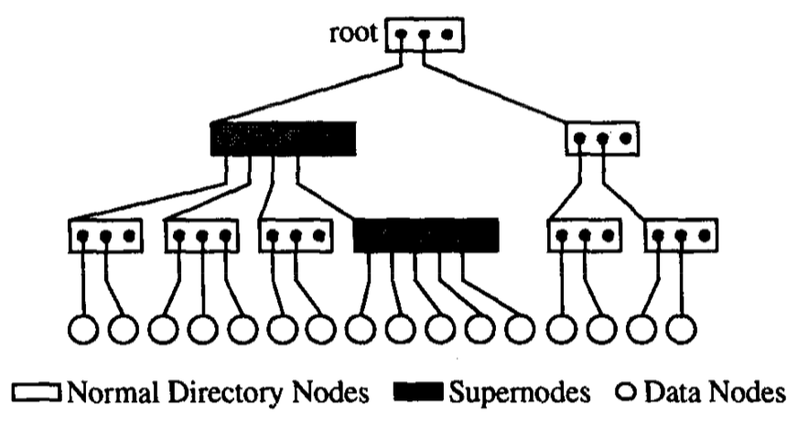
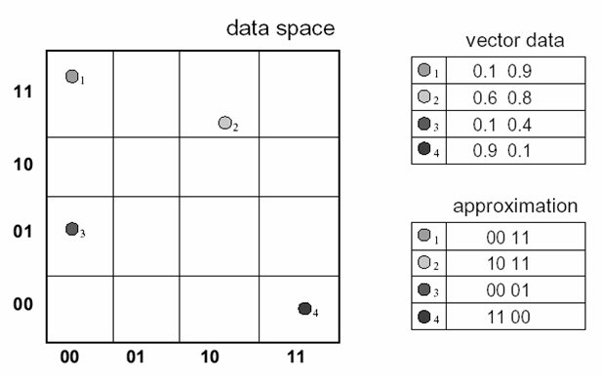
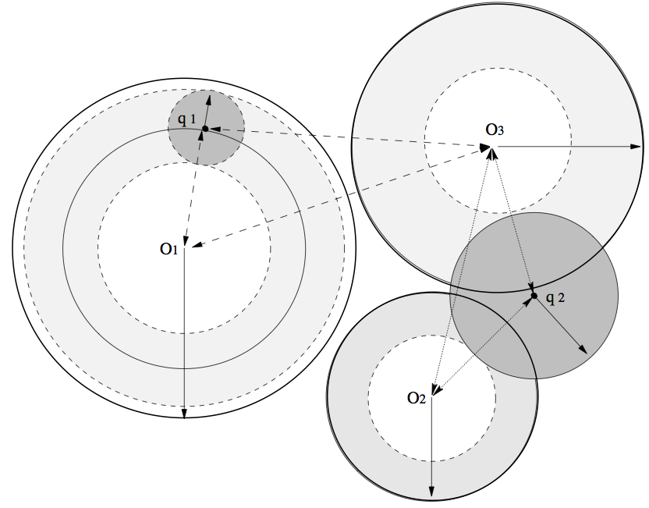
High-Dimensional Indexing

Slide 49
MM Databases
Multimedia is a much more powerful communication tool than traditional data in our daily life
Image showcase, graphic design, TV commercial, speech, movie, mobile phone multimedia message, etc
We need to organize, manage and search these new multimedia data
RDBMS are no longer suitable for complex multimedia data
Need for robust systems which can manage and search multimedia data in a reliable and efficient way

Slide 50
From Spatial to Multimedia
Very different on the surface, but many similarities fundamentally
Data represented as multidimensional vectors
Keywords-based vs Content-based search
Keywords-based: using text annotations
Content-based: using automatically extracted features such as colors, textures and shapes
Both have advantages and disadvantages
Applications of content-based multimedia search

Slide 51

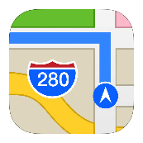




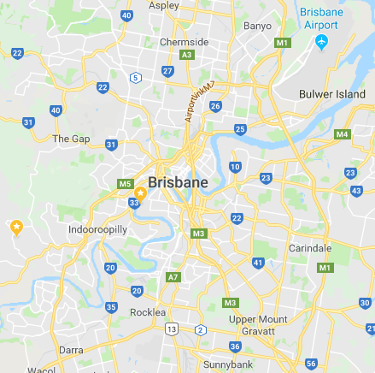
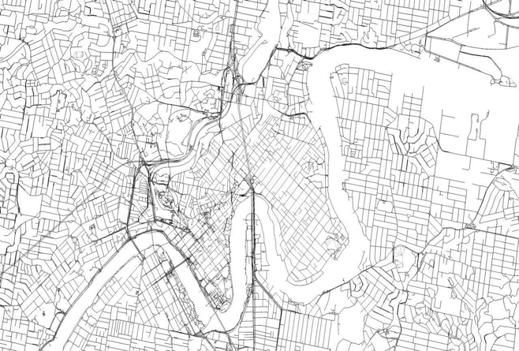
Route Planning in Road Network
Digital Maps & GPS
Any resolution
Accurate location information
Accurate distance
Traffic information
Road Network
Roads, Intersections
Path planning with algorithms

Slide 52
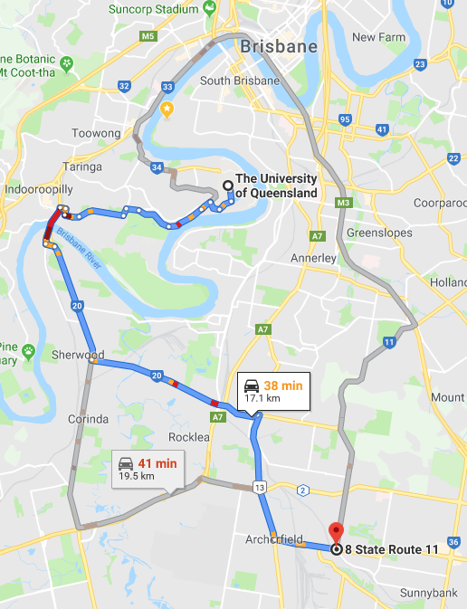
Route Planning in Road Network
Shortest path from UQ to Coopers Plain
Fastest path from UQ to Coopers Plain when I depart at 5pm
Fastest path from UQ to Coopers Plain when I depart between 5pm and 7pm
Paths from Indooroopilly, City and Woolloongaba to UQ such that everybody can arrive by 10am
Fastest path from West End to Airport with toll fee under $6 (Go Between? M7?)
Earliest to arrive Coopers Plain by bus when I depart at 5pm with exchange times under 3
I want to spend at least 3 hours at UQ, 1 hour at Garden City, 1 hour at Southbank Parkland and arrive home by 9pm, what’s the schedule to waste the least time for transportation?

Slide 53
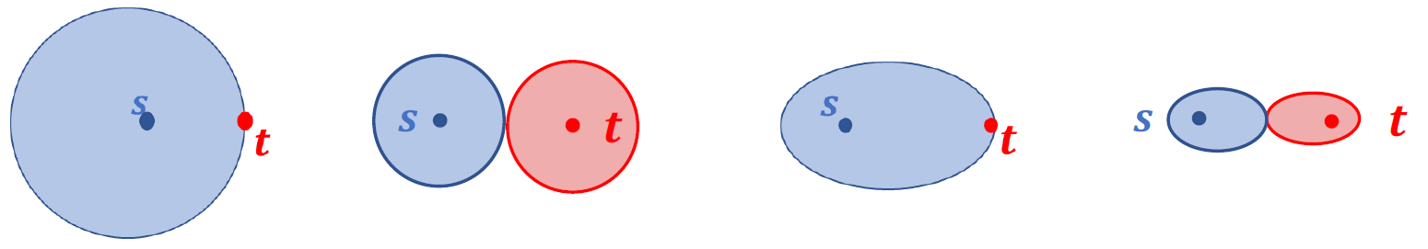
Route Planning in Road Network
Index-Free Algorithms
Dijkstra’s, Bi-Dijkstra’s, A*, Landmark-A*, Bi-A*,…
Basis of the path finding
No precomputation
Adapt to dynamic environment
Online Search
Search Space determines performance

Slide 54
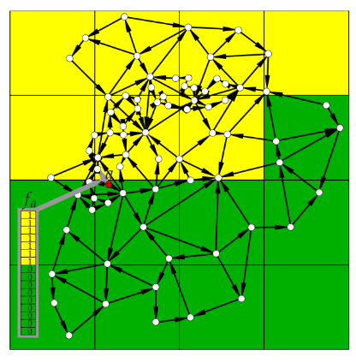
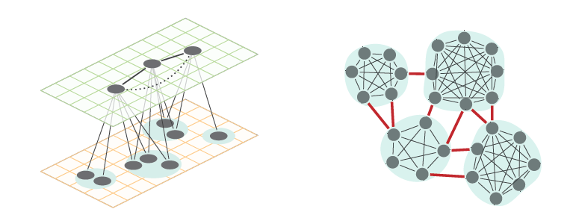
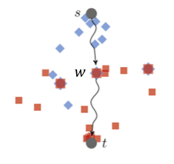
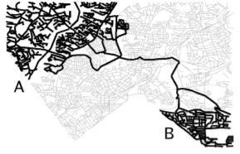
Route Planning in Road Network
Index-Based Algorithms
Various of precomputed information for faster path finding
Online Search
Goal-Directed
Separator-Based
Hierarchical
Hop-Labeling
Materialized

Slide 55
Some Other Recent Projects
Vehicle GPS trajectories
Route planning
Telecom token data analysis
Bluetooth data at road intersections
Social media recommendation for next POI
Processing and annotation for biomedical images
Entity linking and location privacy protection
Smart City, IoT and 5G
Notes:
Industry links

Slide 56
Learning Modules
 | Date | Lecture | Lecturer
1 | 22/6 | Course Introduction and RDBMS Review | Prof Xiaofang Zhou
2 | 22/6 | Introduction to Spatial Databases
3 | 23/6 | Spatial Data Organisation | Dr Lei Li
4 | 23/6 | Spatial Query Processing
5 | 24/6 | Managing Spatiotemporal Data | Dr Pingfu Chao
6 | 24/6 | Managing High Dimensional Data | Dr Lei Li
 | 25/6 | 端午节
7 | 26/6 | Advanced Topic: Route Planning in Road Networks | Dr Lei Li
8 | 26/6 | Future Trends, Course Review and Discussions | All
 |  | Revision Period
 | 9 July | Final Report Due

Slide 57
Why Study This Course?
For a student in CS/SE
What you have learnt about relational DB may be not applicable to some applications, but…
For prospect researchers
Spatial and multimedia databases are still a major area with many open problems, and there are many other types of high dimensional data
For job seekers
Complex data are typically dimensional
High-dimensional data management and processing evolve rapidly from a specialised area to a “commodity” skill with great demand

Slide 58
Your Homework
Take one application area that you are familiar with, or you are interested
What types of spatial or spatiotemporal data in the application?
How such data have been and could be used, for what applications?
If RDBMS is the technology to use to manage such data, do you see any problems?
Consider another high-D application area, and repeat the above
Who are the main technology providers and users for spatial databases? Name a few products

